Slide 1
The Generalized Fractal Dimensions of Particle Clusters in Free Surface Turbulence
Jason Larkin
Department of Mechanical Engineering and Materials Science, University of Pittsburgh.
Mahesh M. Bandi
Center for Nonlinear Studies and Condensed Matter & Thermal Physics Division,
Los Alamos National Lab.
Walter Goldburg
Department of Physics & Astronomy, University of Pittsburgh.
LA-UR-07-7929, NSF

Slide 2
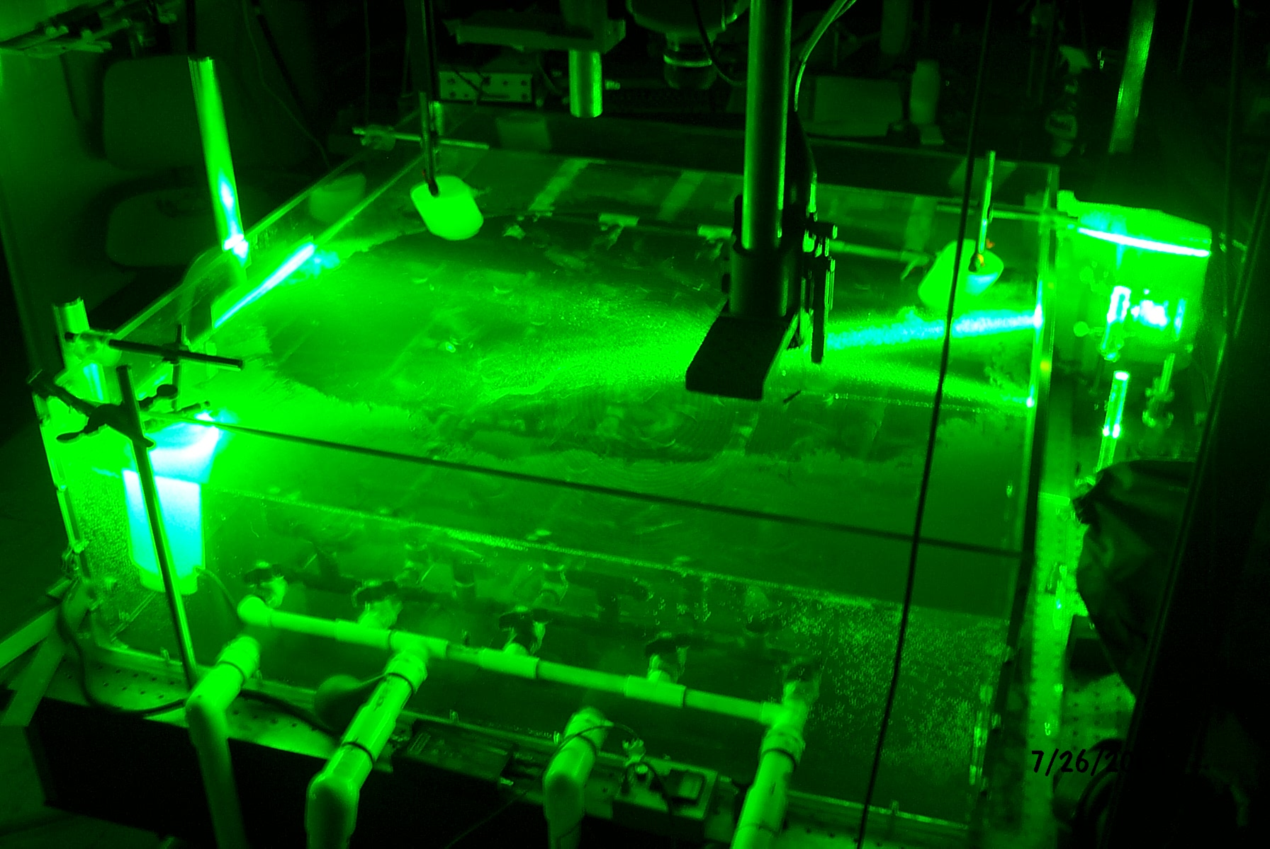


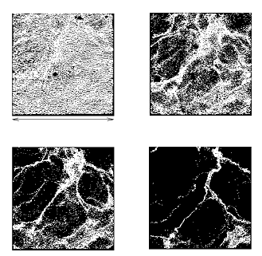


Experiment Overview
GOAL: Measure fractal dimensions of particles on surface of turbulent tank of water.
Tank size: 1 m x 1 m x 0.3 m
50 micron particles (sg 0.25)
Camera Field of View: 9cmx9cm
8 hp pump drives “sprinkler” system.
Particles driven by turbulence of water.
Instantaneous velocity fields measured by high-speed camera.
Particles are highly bouyant.
Notes:
-

Slide 3
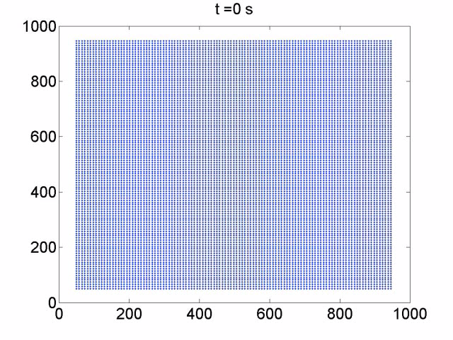
Evolution of Virtual Particles
Virtual particles evolved using measured velocity fields.
At t=0 particles uniformly distributed.
12,000 virtual particles in Field of View in each frame.

Slide 4
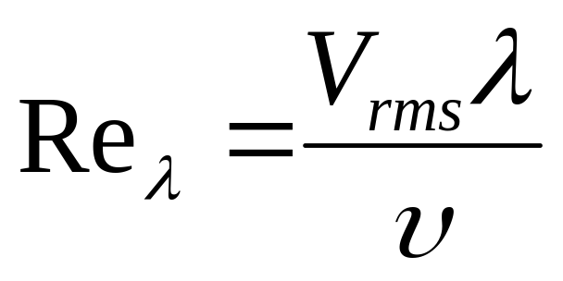
Investigate fractal dimension dependence on Re_{λ}
Taylor-Microscale Reynolds Number:
Data taken at Re_{λ} = 50 and Re_{λ} = 120-170

Slide 5
Fractal Dimensions and Turbulence
This phenomenon has been studied at the Kolmogorov (dissipative) scale.
G. Boffetta, J. Davoudi and F. Delillo. “Miltifractal Clustering of Passive". Europhys. Lett. 74, 62 (2006).
J. Bec, K. Gawedzki, P. Horvar, PRL, 92, 224501 (2004).

Slide 6
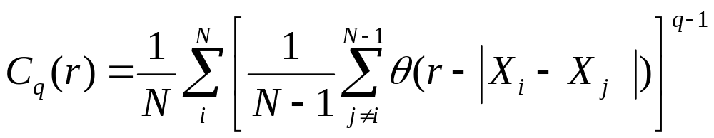
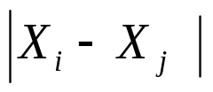

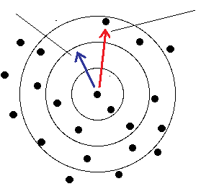
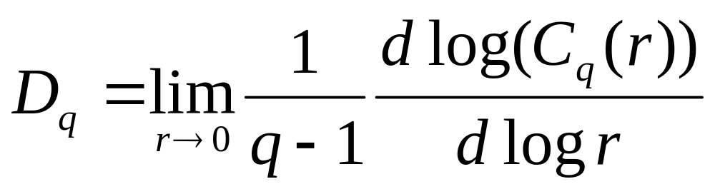
Generalized Fractal Dimensions
Correlation Sum¹:
Generalized Fractal Dimension¹:
-Measured D_{q}(t) for q=0,1,2
-r is non-dim.
¹P. Grassberger and I. Procaccia (1983). "Measuring the strangeness of strange attractors". Physica 9D: 189-208.

Slide 7
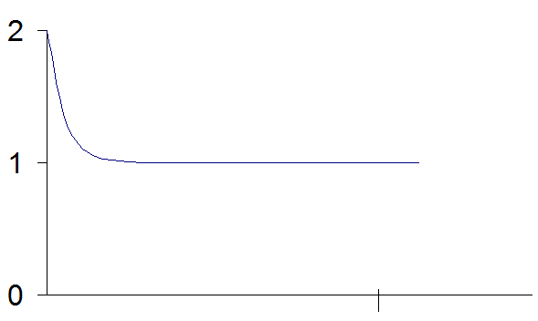
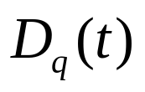



Coagulation of Floaters
Simple Fractal Dimensions:
Line: D_{q}=1 Surface: D_{q}=2
If Re_{λ}=0, D_{q}(t)=2
If fluid rolls laminar, what will D_{q} be in Steady-State?

Slide 8
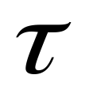
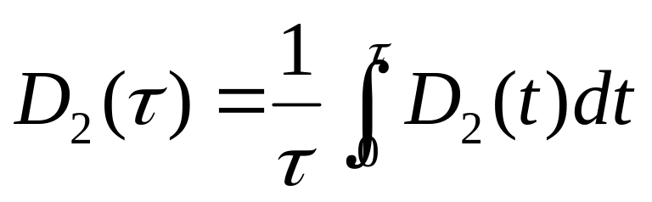

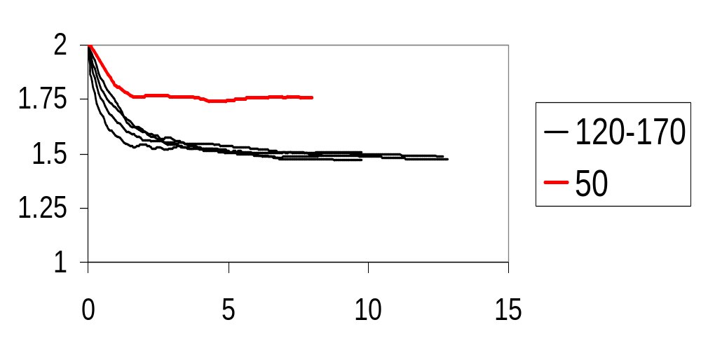
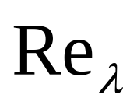
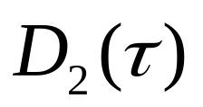
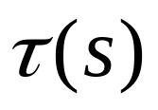

Measurement of D₂( ) for Various Re_{λ}
Time-averaged value of D₂(t) for increasing averaging time.
t=0,7.5ms,15ms…
D₂(0)=2 for all Re_{λ}
Steady-State values of D₂( ) independent of Re_{λ} =120-170.
For Re_{λ} =50, flow is close to laminar (where D₂( )=1 or 2).

Slide 9
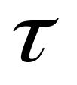
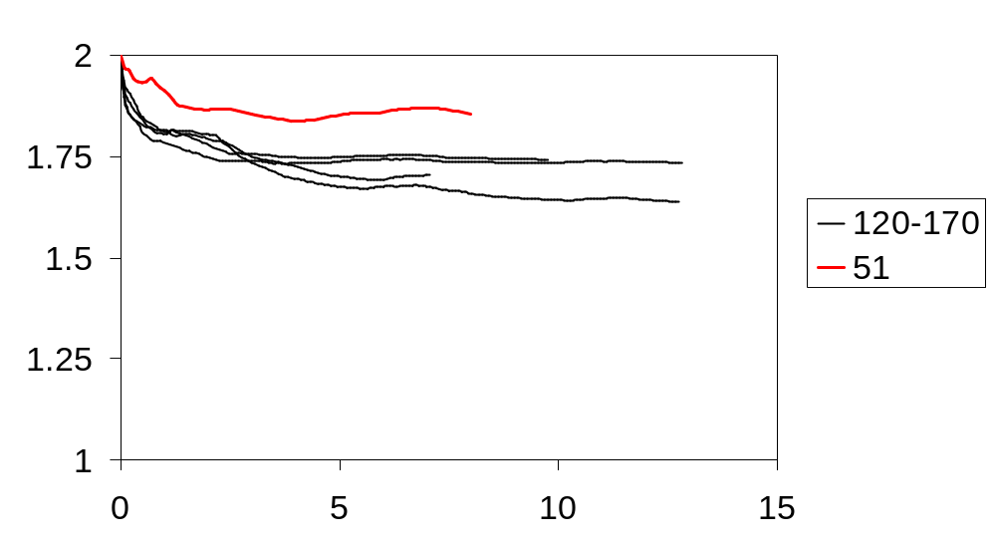

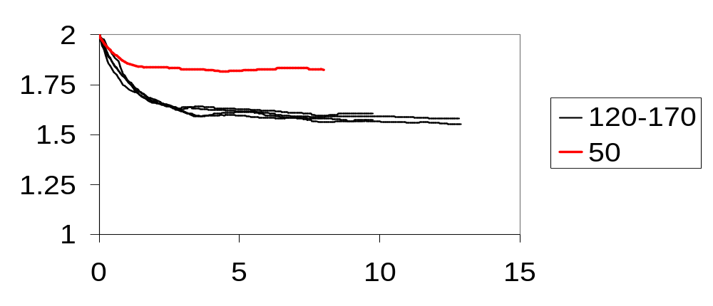

Measurement of D₀( ) and D₁( ) for Various Re_{λ}
Steady-State values of D₁( ) and D₀( ) independent of Re_{λ} =120-170.

Slide 10
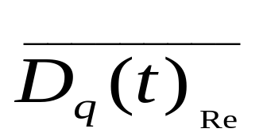
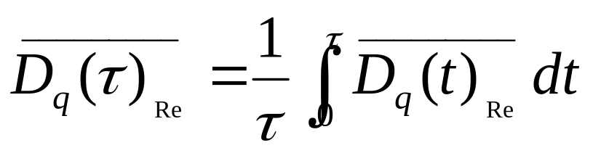
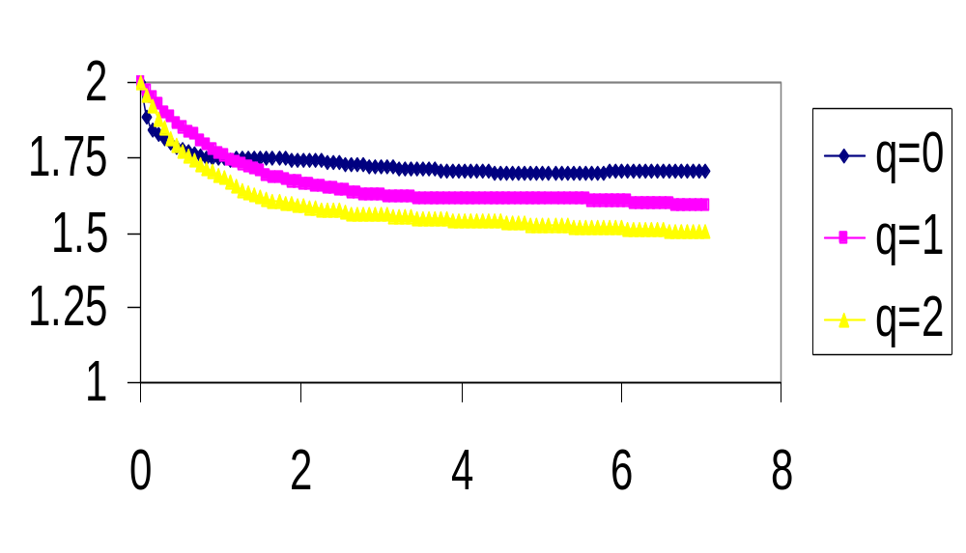
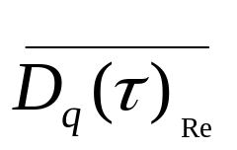

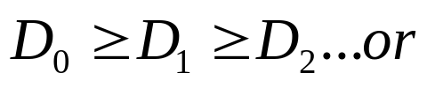
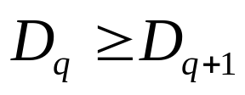
Ensemble Measurement of D_{q}( ) for q=0,1,2
Ensemble Average of Re_{λ}= 120-170:
Ensemble and time average:
Steady-State Values
q | D_{q}
0 | 1.706
1 | 1.591
2 | 1.501
Steady-state values of D_{q}(t) agree with 2-D chaotic maps where:
LA-UR-07-7929

Slide 11
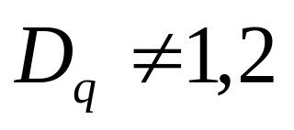
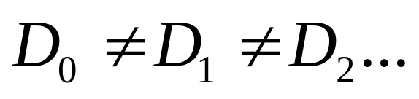
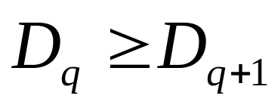
Results
Steady-state value of distribution of floaters is non-homogeneous and multifractal:
Time evolution of the fractal dimensions q=0,1,2 have been measured.
Results in the steady-state agree with 2-D chaotic maps for q>=0:
Steady-state value of D_{q}(t) appears to be independent of Re_{λ} for Re_{λ}= 120-170.
Future Work: investigate fractal dimensions for Re_{λ}= 50-120.
LA-UR-07-7929

Slide 12
Questions?
M.M. Bandi was supported by the Center for Nonlinear Studies through the program on Multiscale Modeling, carried out under the auspices of the National Nuclear Security Administration of the U. S. Department of Energy at Los Alamos National Laboratory under Contract No. DE-AC52-06NA25396.
LA-UR-07-7929

Slide 13
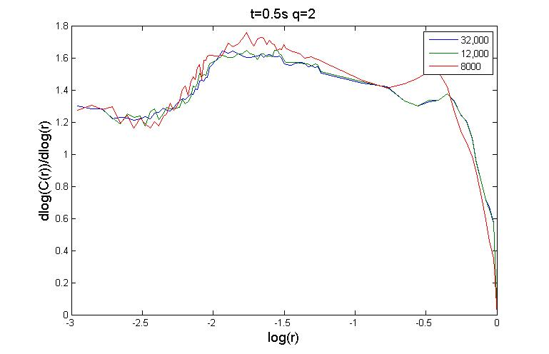
Test for Convergence

